Slide 1
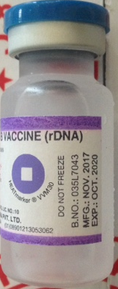
AUTHORISED HEPATITIS B VACCINE ON THE MARKET
Manufactured by Serum Institute, India.
Supplied in the Multi dose (10ml) Hepatitis B Vaccines (rDNA).
Importer - Norvik Enterprises Ltd
Batch number
Manufacturing and expiry dates
Shelf-life of 3 years
Two purple bands (top and bottom) on the label
Strictly supplied to public (government) sector bearing the words, “Government of Uganda, Not for sale”

Slide 2
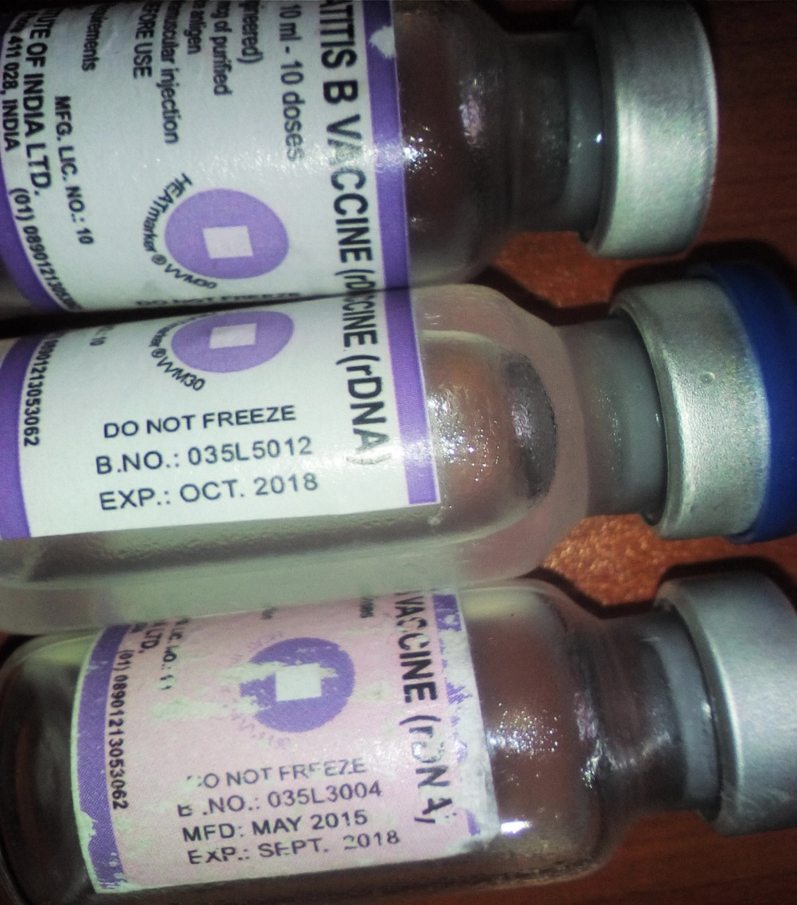
Counterfeit HEPATITIS B VACCINE
Batch Numbers
035L3004 MFG.: May 2015 EXP.: Sep 2018
035L5012 MFG.: date not indicated EXP.: Oct 2018
035L 6010 MFG.: May 2016 EXP.: April 2019
035L5010 MFG.: date not indicated EXP.: Sep 2019
035L6005 MFG.: date not indicated EXP.: 09/2019
035L 5017 MFG.: date not indicated Exp.: Oct 2019
035L5013 MFG.: 11/2017 EXP.: 01/2020
035L006 MFG.: Mar 2016 EXP.: Feb 2020
035L7037 MFG.: 10/2017 EXP.: 9/2020

Slide 3
Counterfeit HEPATITIS B VACCINE
All had batch numbers and expiry dates but some had no manufacturing dates.
Shelf life varies from the 3 years on the genuine product.
Words on vial can be easily rubbed off.

Slide 4
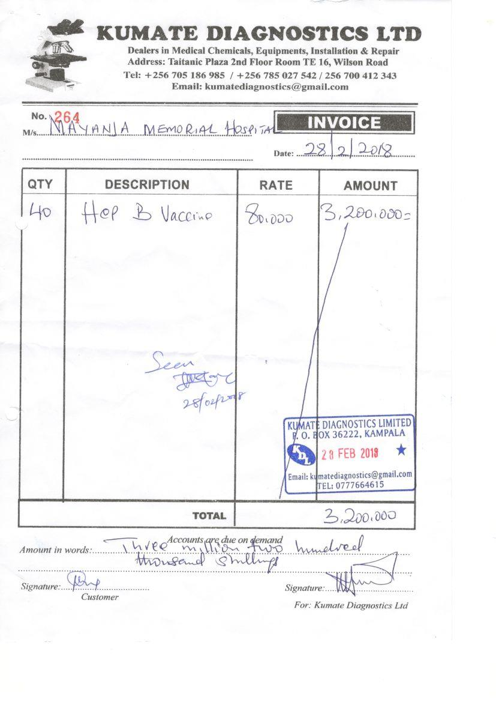
Fake addresses on the invoices/receipts
Bought from unlicensed dealers with fake addresses on the invoices/receipts, and supplied to private health facilities

Slide 5
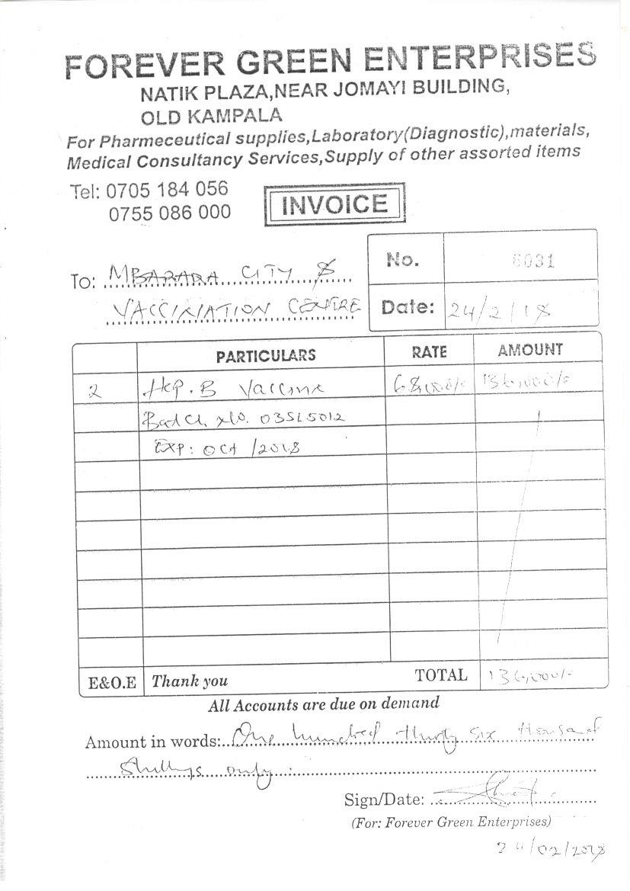
Fake addresses on the invoices/receipts

Slide 6
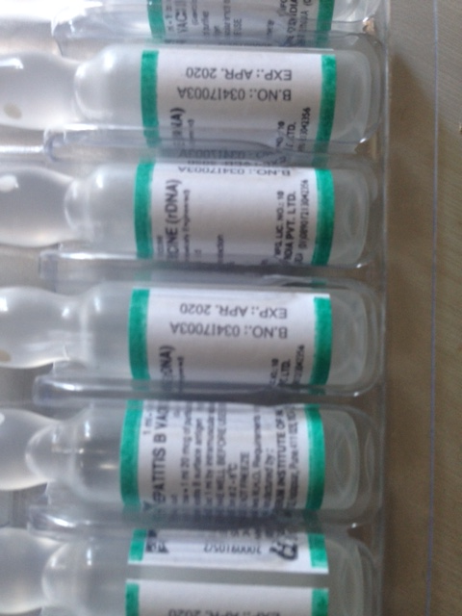
Hepatitis B Vaccine available in the private sector
The only Hepatitis B Vaccine from Serum Institute of India available in the private sector is the 1 ml ampoule which has two green bands on the label.

Slide 7
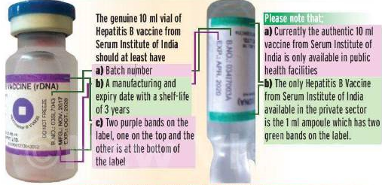
AUTHORISED HEPATITIS B VACCINE ON THE MARKET

Slide 8






BE VIGILANT ABOUT YOUR HEALTH AND THAT OF OTHERS.
Safe Drugs Save Lives
Follow us on - Toll free line 0800 101 999 ndaug@nda.or.ug Uganda National Drug Authority
@UNDAuthority www.nda.or.ug

